Slide 1
Byzantine Reliable Broadcast Project
Outline:
Description of the BRB-protocols
Problems encountered and proposed solutions
Simulation settings
Simulation Results
Conclusions

Slide 2
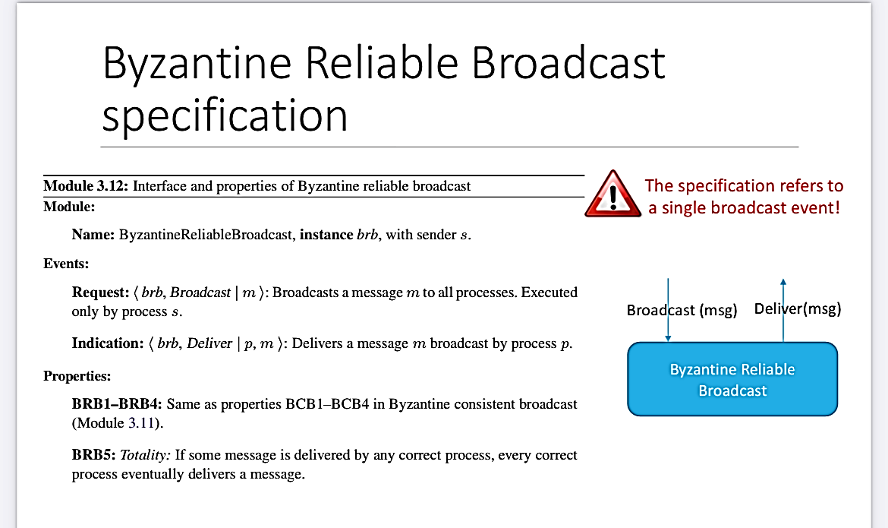
1. Description of the protocols
Properties of BCB:
BCB1: Validity: If a correct process p broadcasts a message m, then every correct process eventually delivers m.
BCB2: No duplication: Every correct process delivers at most one message.
BCB3: Integrity: If some correct process delivers a message m with sender p and process p is correct, then m was previously broadcast by p.
BCB4: Consistency: If some correct process delivers a message m and another correct process delivers a message m’ then m’ = m

Slide 3
Assumptions
The server(s) address(es) is(are) known to every process in the network
Every process knows the ID of the broadcaster that is settled to one in our implementation;
The broadcaster brodacasts the message only to processes that it knew about before the broadcast primitive, so subsequent receivers, that connect to the service afterwards, will not receive it;
The network is fully connected;
In the Bracha code Algorhtm, every array that contains messages of a specific type is checked according to an interval of time (e.g every .001 s);
The message is considered delivered when the "- - - - -Message Delivered - - - - -" string is prompted in the terminal;
All the algorithms use SHA256 cryptographic hash function;
Authenticated Messages code algorithm uses the ‘RSA’ API interface in order to make the digital signatures;
Erasure Code algorithm uses the ‘pyeclib’ API interface in order to derive the shares;
A faulty process is a process that discards every message that it receives after the time it fails;
Erasure Code algorithm considers the "source" field of a message instead of the "from" message field for finality and soundness reasons;
Byzantine processes are modeled with specific python modules.

Slide 4
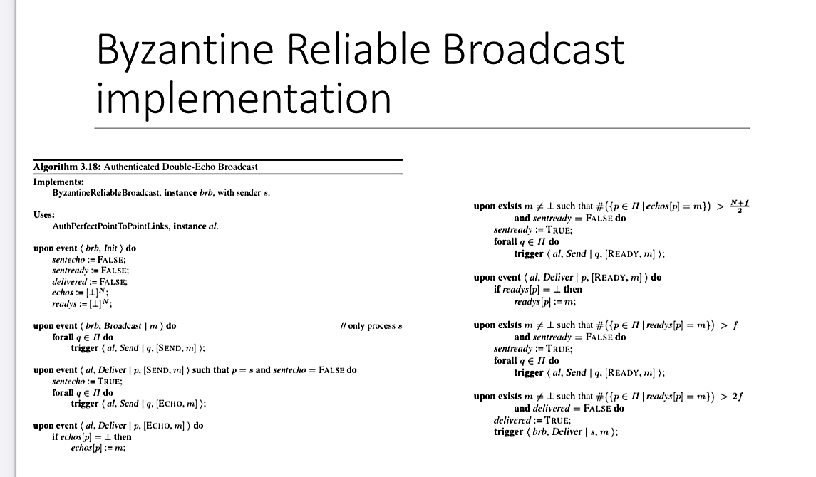
BRB-double-echo pseudocode
Modules:
Authenticated Link
BRB Process
Server(s)

Slide 5
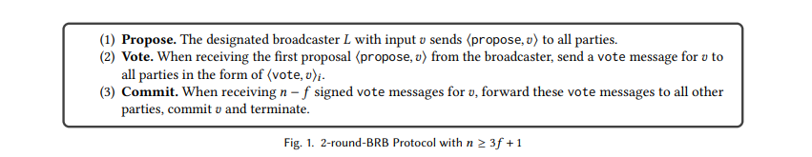
Authenticated Messages Pseudocode
Modules:
Link → used for the vote message phase
Authenticated Link → used for the propose message phase
BRB Process → module that characterizes the protocol implementation
Server(s) → server for process identification

Slide 6
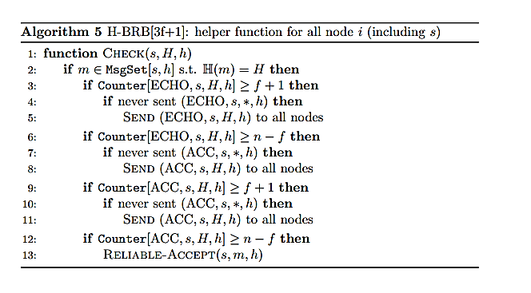

Hash Based Pseudocode
Modules:
BRB Process
Server
Authenticated link

Slide 7
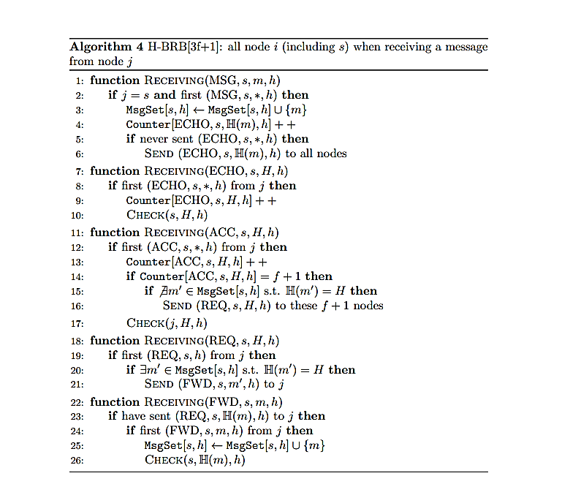
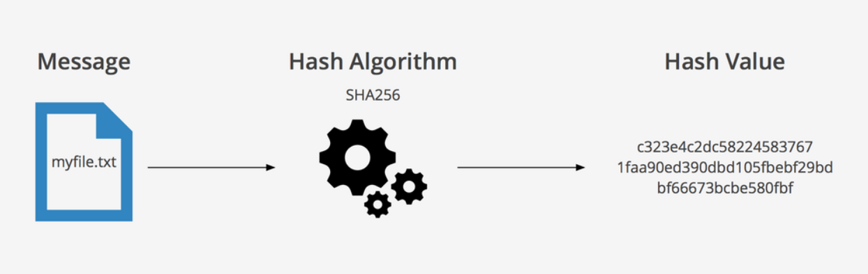
Hash Based Pseudocode
For each message flag a different receiving functions
Message identified by (source,SN) tuple
For each message flag a different counter
Counter indexed on the key (flag,source,Hash(m),SN)
Check function to verify if some type of counter exceed a bounded threshold to take the required actions
Hashing used → SHA256

Slide 8
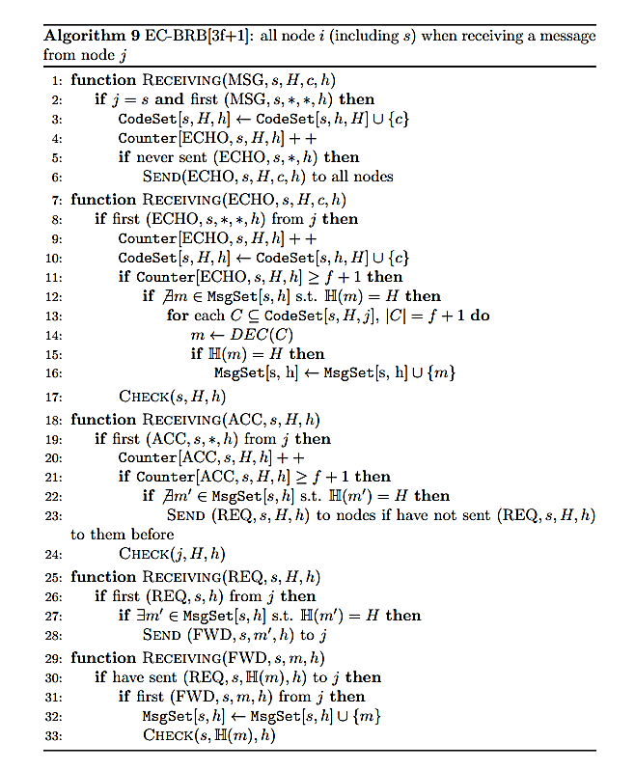
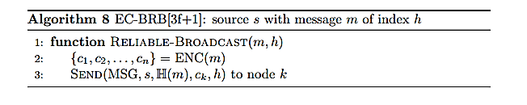
Erasure coding pseudocode
Modules:
BRB Process
Server
Authenticated link

Slide 9
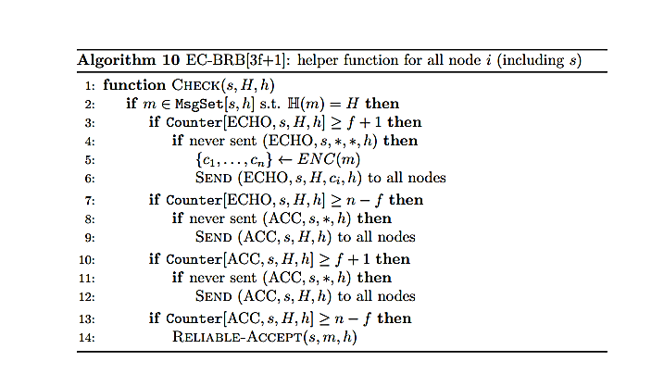
Erasure coding pseudocode
Similar to the others specifications we have the reliable broadcast primitive
The message is divided into fragments
Different receiving functions for each flag
Check function similar to the HB one
Counter structures similar to the HB ones
Codeset indexed on tuple (source,H(m),SN)

Slide 10
2. General problems encountered and solutions
Not very familiar to the simulation tools
Few documentation for the encryption functions
Difficult to find a suitable python library for MDS-Erasure Code
Difficult to decide between robustness of the protocol and efficiency
Difficult to manage links module implementation and APIs
Difficult to code from scratch the suitable links module implementation
Not always clear stated some features and steps of the protocols pseudocode
Difficult to set up a basic benchmarking to debug
Limit to the SW/HW resources

Slide 11
3. Simulation settings
In the simulation of the four protocol we have considered the following metrics to evaluate them:
- average elapsed time of the protocol;
- average memory usage;
- average bandwidth.
We modelled the network topology as a complete graph, so every process could communicate with every other process. The network topology is modelled as a star topology with a switch in the middle.
In the simulation we varied the number of processes from 4 to 20, the number of message bytes to transmit from 256 bytes to 2048 bytes and the bandwidth from 500KBPS to 1GBPS.
The average time metric is computed through the median of the total time required for each protocol to deliver the message. The average peak metric is the total memory used by a single protocol.

Slide 12
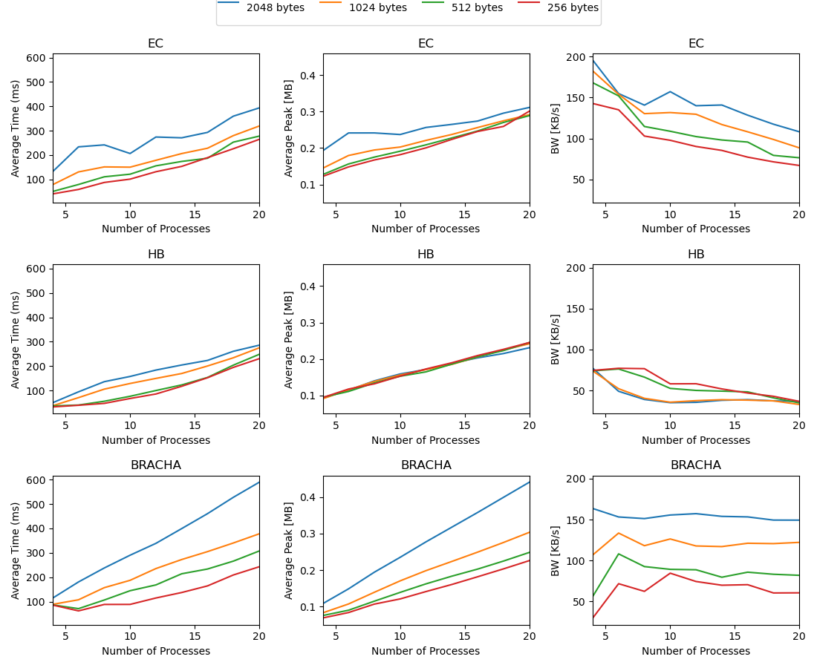
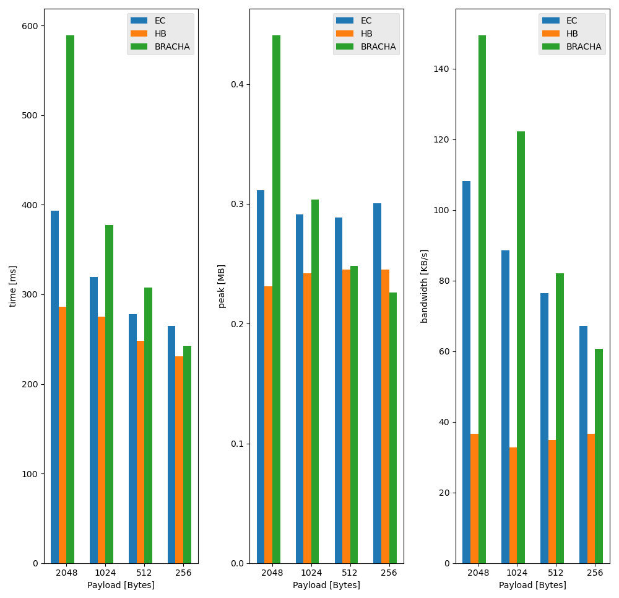
4. Simulation results

Slide 13
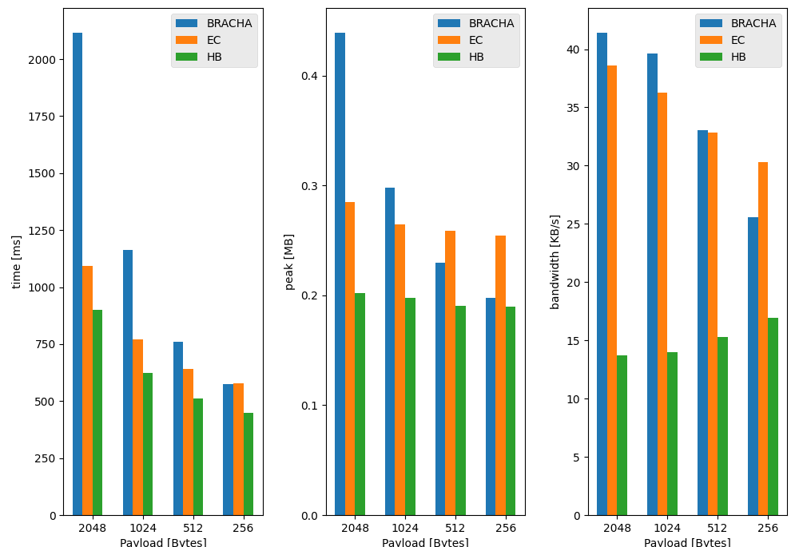
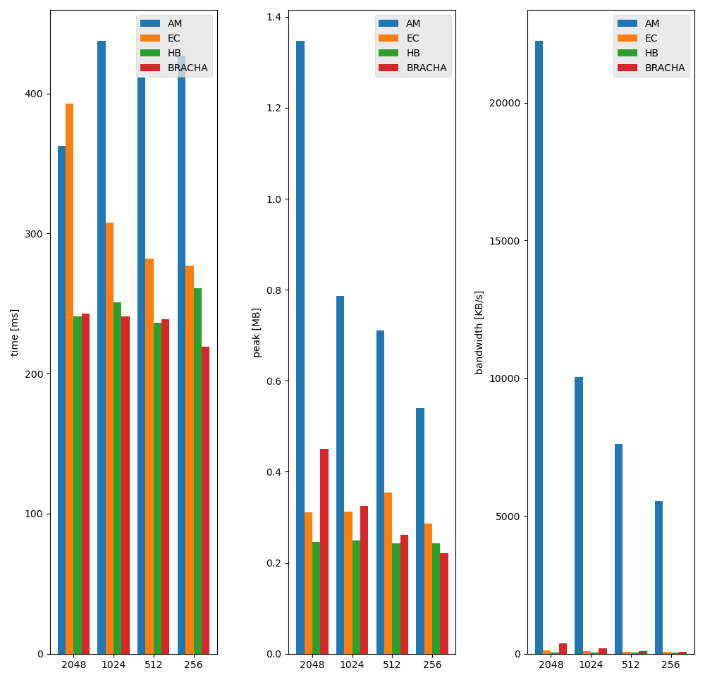
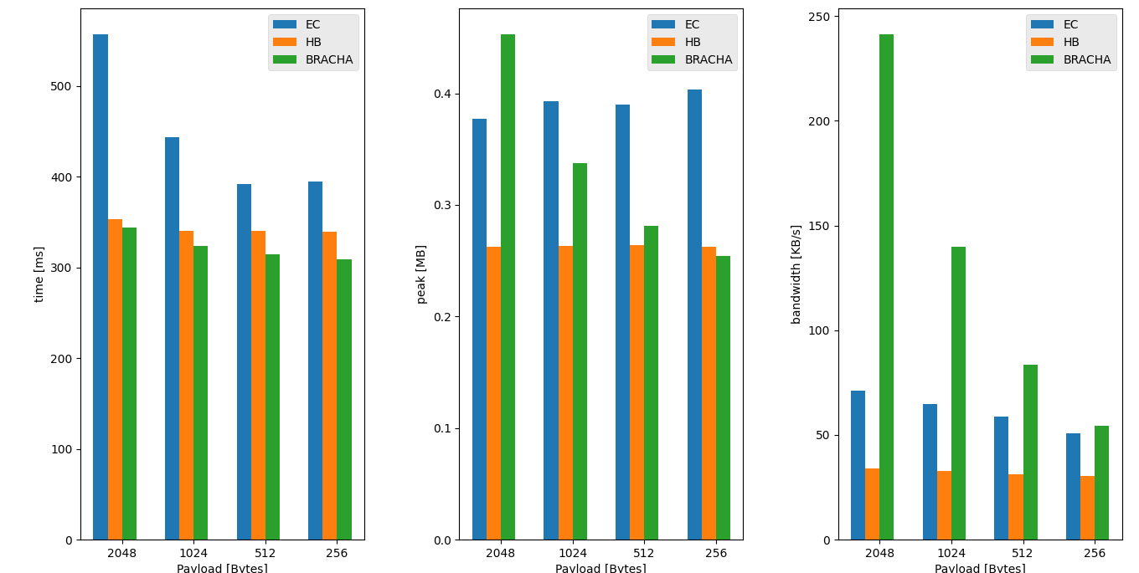
500KBPS
1GBPS
10MBPS

Slide 14
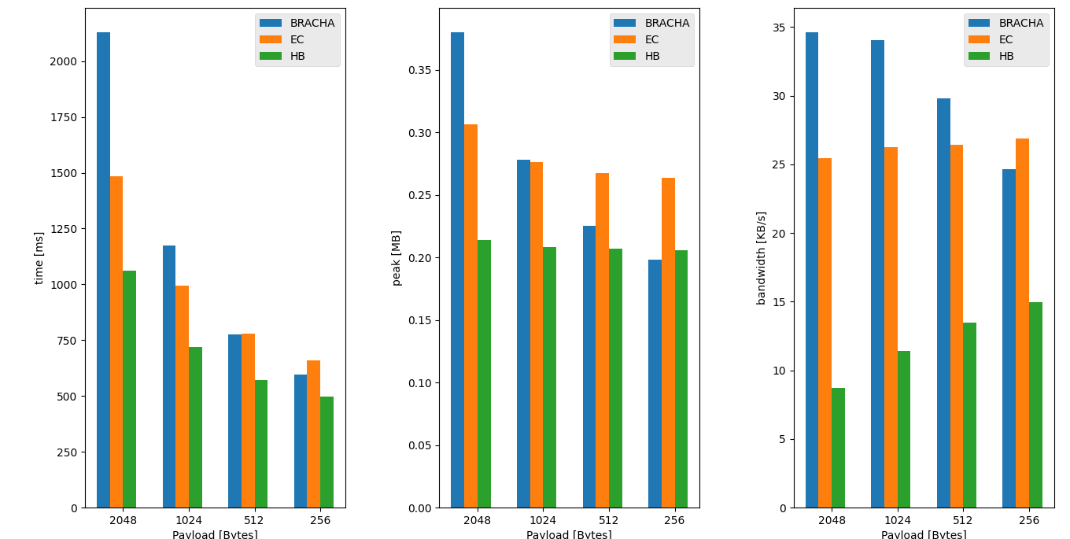
6BYZ-500KBPS
6BYZ-10MBPS

Slide 15
5. Conclusions
In the average case, HB is the best protocol thanks to the hashing function that reduces all messages to a fixed length. If the number of processes, the bandwidth and the payload of each message (and consequently, the data exchanged between processes) are limited, the BRACHA protocol is the most efficient one.
When there is an high number of faulty processes (it does not matter if they are byzantine or just faulty) or there are no constraints on the bandwidth, the EC protocol is the one that obtains the best performances (although, in the case of unlimited bandwidth, the difference with HB is not so relevant).
Because of the cryptographic primitives used by the protocol, AM is not comparable with respect to the other protocols in terms of all the metrics defined in the evaluation.
If for any reason an application needs the non repudiation requirement as a principal goal, the AM protocol meets the needs perfectly and it is the preferred one to use among all the four protocols evaluated.
Furthermore the implementation of the protocol is easier for the restricted number of protocol messages issued and it is also much more understandable in terms of the specification description.
The overall number of messages exchanged by the protocol is less than other protocols.
The elapsed time of the protocol is bounded to the last phase of the algorithm where there is an high number of steps for the verification of the n-f messages received; furthermore, the protocol uses a third entity (KDS) to distribute the keys needed for the cryptographic primitives that leads to higher delays.
Because of the reasons stated above, the following evaluation is centered on the remaining three protocols.
Protocols that send all the payload are better wrt the others if the payload size is small; when the payload increases, the Erasure-Code and Hash-Based protocols are better than the Bracha one because they send a smaller packet. The erasure code protocol sends the shares of the message and although they are smaller than the message they are longer than the hash; so hash based is the best among the four protocols. Furthermore Bracha has a simpler implementation and the overall number of messages exchanged is smaller than the other protocols.
Hash-Based remains the best because of the crypto hashing function that bounds the length of the payload to a fixed length, independently from the message size.

Slide 16
Byzantine Reliable Broadcast Project
● Number of group members: 3
● Members: Gianmarco Bordin, Carlo Giralda, Gabriele Lerani
● Student IDs: 2081387, 1903088, 2093689

